Slide 1

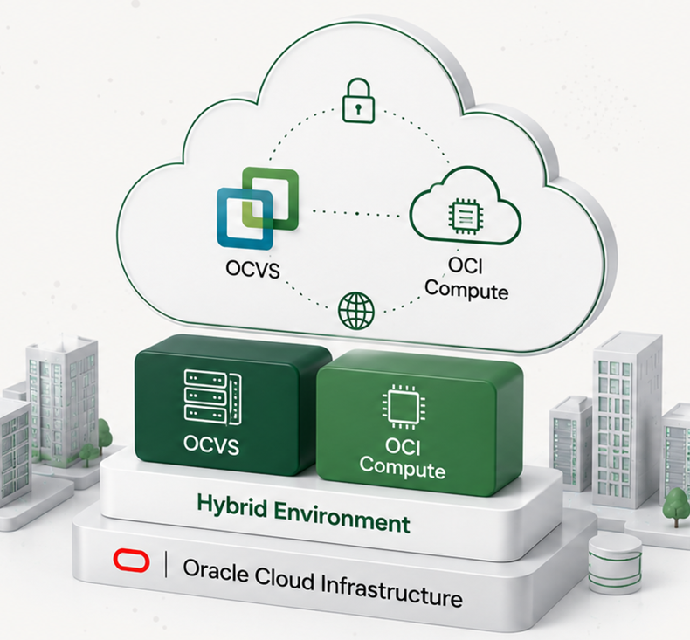




Hybrid Scenario
OCVS + OCI Compute
Proposed Sizing
Customer
CLIENT
Date
May 2025
Prepared By
Oracle Cloud VMware Specialist
Notes:
[Sources]
Source image: user-provided screenshot "Hybrid Scenario". Logo, customer/date/prepared-by icons, Oracle mark, and the right-side hybrid infrastructure illustration are embedded as cropped image assets from that screenshot; visible title, subtitle, sizing label, customer/date/prepared-by labels and values are editable PowerPoint text.

Slide 2




























Hybrid Migration with Oracle Cloud
Combine Oracle Cloud VMware Solution (OCVS) and OCI Compute to modernize workloads at your own pace.
BUSINESS OUTCOMES
Flexibility to run and
modernize at your pace
Optimize costs and
improve efficiency
Leverage best-in-class
security and reliability
Accelerate innovation
with cloud-native services
Lower Costs
Optimize infrastructure and
reduce operational costs.
YOUR CURRENT ENVIRONMENT
MIGRATION & WORKLOAD MOBILITY
TARGET ENVIRONMENT (HYBRID)
Modernize & Innovate
VM
VM
VM
...
VM
Use OCI native services to
accelerate innovation.
On-Premises VMware Environment
VMware Workloads
to OCVS
Workloads to
OCI Compute
Flexible & Scalable
HCX Mobility
OCI Migrations (OCM)
or Third-Party Tools
Scale on demand across
OCVS and OCI.
Production workloads
OCVS
OCI Compute
Secure, seamless migration
of VMware workloads
to Oracle Cloud VMware
Solution.
Migrate and modernize
workloads to OCI Compute
using OCM or partner tools.
Run VMware
Modernize
Secure & Reliable
Business critical applications
Enterprise-grade security
and high availability.
Users & business operations
CONNECTIVITY OPTIONS
Unified Management & Security
Consistent security, governance and
management across all environments.
Future Ready
At risk from cost, complexity
and technical debt
Build a modern, agile
foundation for the future.
Internet
VPN
FastConnect
Modernize at your own pace by combining Oracle Cloud VMware Solution
and OCI Compute in a unified cloud architecture.
Copyright © 2026, Oracle and/or its affiliates
Confidential: Internal/Restricted/Highly Restricted

Slide 3









Assumptions & Methodology
The proposed sizing is based on the information provided by the customer
and the following assumptions and methodology.
Sizing Methodology
Data Source
RVTools export provided by the customer
(Analysis Date: May 08, 2025)
Sizing Approach
Capacity based on current utilization
and projected growth
CPU Contention Ratio
1:6
(Industry standard for medium consolidation)
Average Utilization
vCPU: 50%
vMEM: 60%
Target Utilization
80%
(For both vCPU and vMEM)
Storage Type
OCI Block Volume
(Block Storage)
Copyright © 2026, Oracle and/or its affiliates | Confidential: Internal/Restricted/Highly Restricted

Slide 4


0
0
0
0
0
0
Current Environment
Analysis based on the selected RVTools assessment scope.
Selected Environment
Source cluster
VMs
vCPUs
vRAM (GB)
Storage (TB)
Source cluster
0
0
0
0
Source cluster
0
0
0
0
Source cluster
0
0
0
0
Source cluster
0
0
0
0
Source cluster
0
0
0
0
Source cluster
0
0
0
0
TOTAL SELECTED SCOPE
0
0
0
0
Copyright © 2026, Oracle and/or its affiliates | Confidential: Internal/Restricted/Highly Restricted

Slide 5

0
0
0
0
0
0
0
0
0
0
0
0
0
0
0
0
0
0
0
0
0
0
0
0
0
0
0
0
0
0
0
0
0
0
0
0
0
0
0
0
0
Infrastructure Sizing Summary
Target OCVS topology for the Hybrid OCVS subset.
Proposed Architecture
Target OCVS Cluster Distribution
SDDCs
0
Cluster
Workload
Hosts
Shape
Storage
Architecture
Cluster
0 VMs
0
Shape
0 TB
Storage
Clusters
0
Cluster
0 VMs
0
Shape
0 TB
Storage
Hosts
0
Cluster
0 VMs
0
Shape
0 TB
Storage
Cluster
0 VMs
0
Shape
0 TB
Storage
Storage (TB)
0
Cluster
0 VMs
0
Shape
0 TB
Storage
Storage type
0
Cluster
0 VMs
0
Shape
0 TB
Storage
Copyright © 2026, Oracle and/or its affiliates | Confidential: Internal/Restricted/Highly Restricted

Slide 6
Hybrid Pricing Summary
Estimated pricing based on the selected OCI Native and OCVS sizing results.
OCI Native Compute
OCI Native Monthly Cost
Unchanged across OCVS commitment terms
Not available
Commitment Term
OCVS Cost
OCI Native Cost
Hybrid Monthly Total
Hybrid Annual Total
On-Demand
Not available
Not available
Not available
Not available
1-Year Commitment
Not available
Not available
Not available
Not available
3-Year Commitment
Not available
Not available
Not available
Not available
Confidential - Oracle Restricted \ Employees Only
Hybrid Customer Sizing

